Slide 1

ASSIGNMENT 3 & 4
PRINT 'Rutvik Gandhi';
PRINT 'Ricky Satyam';
PRINT 'Pubudu Gunasekara';
PRINT 'Aditya Mandani';
PRINT 'Dhruvil Kumar';

Slide 2
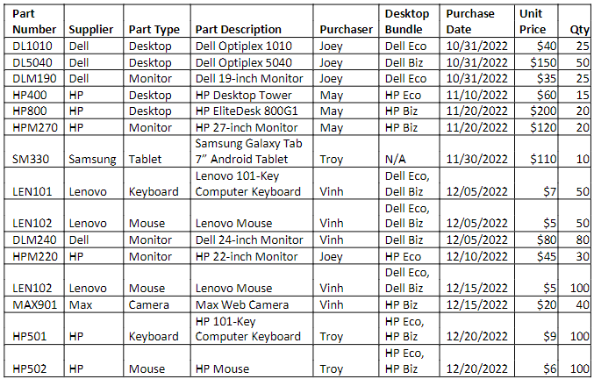

Slide 3
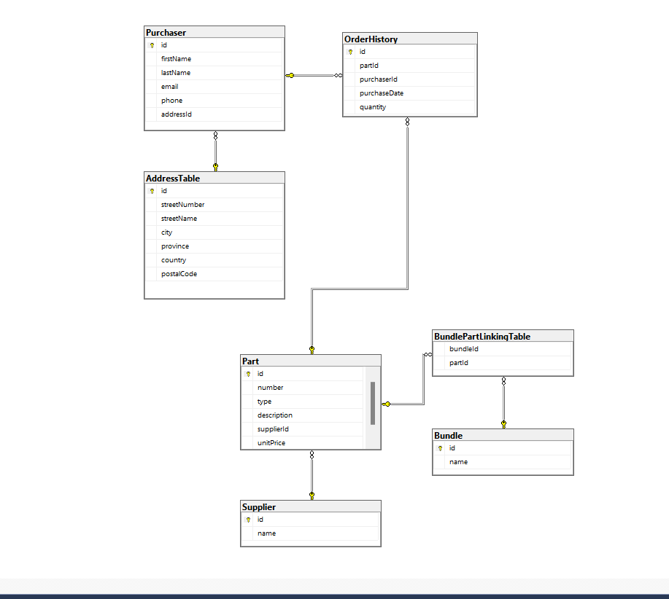
Database Diagram

Slide 4
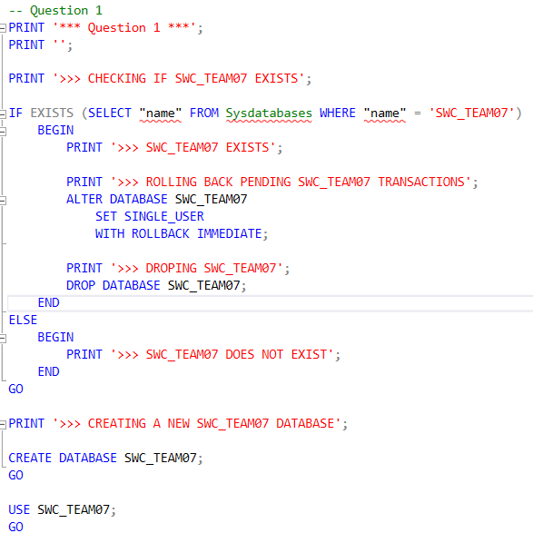
Question 1

Slide 5
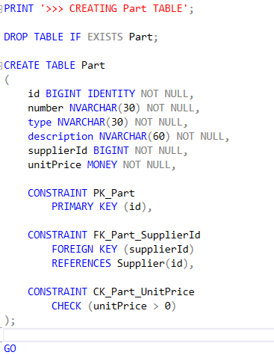
Question 2-7

Slide 6
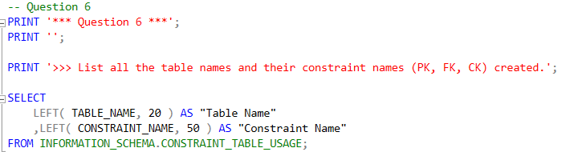
Question 6

Slide 7
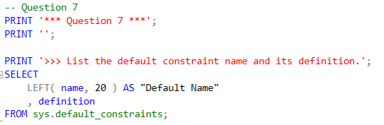
Question 7

Slide 8
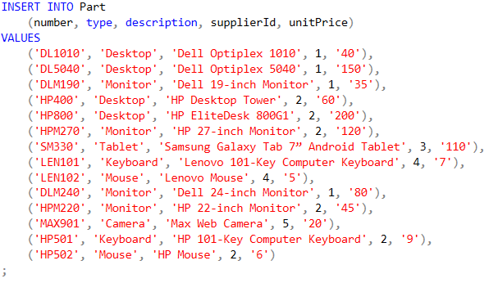
Question 8

Slide 9
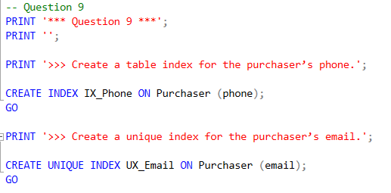
Question 9

Slide 10
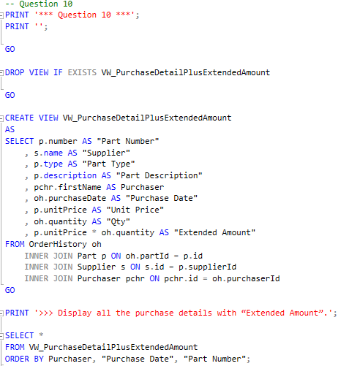
Question 10

Slide 11
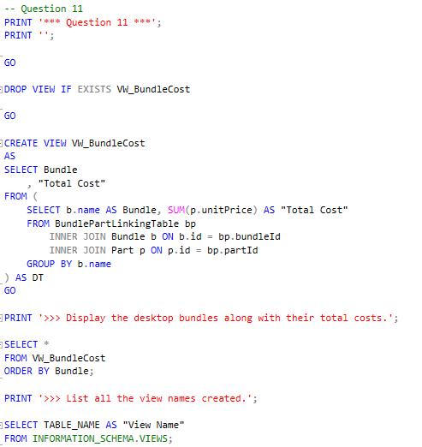
Question 11

